Slide 1

Leadership Clinic
Pre Trip Planning

Slide 2
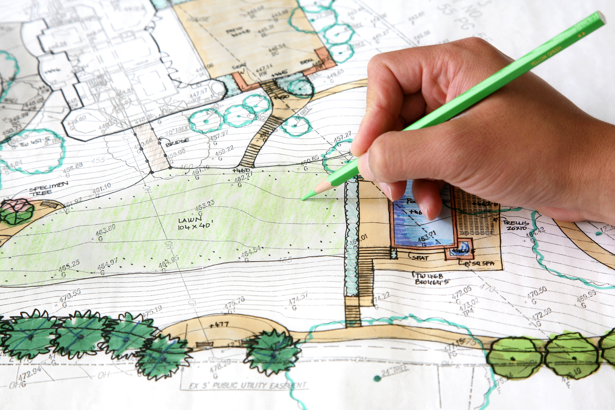
Why Plan?

Slide 3


Fail to plan plan to fail

Slide 4
Three Phases of Pre-Planning

Slide 5
Phase One Deciding, Researching and Trip Planning 6 months – multi-day 1-2 weeks - daytrip
Decide on destination
Gather Information
Work on Details
Sample Details:
Estimated time, distance and elevation
Campsites
Water sources
Permits
Group size limits
Landmarks
Hazardous areas

Slide 6
Phase One Deciding, Researching and Trip Planning
4. Decide on travel logistics
5. Decide on timing – start and finish
6. Plan the route
Route Planning Resources
All Trails
Gaia
BC Marine Trails
https://www.bcmarinetrails.org/

Slide 7
Phase One Deciding, Researching and Trip Planning
7. Make a list of potential hazards
8. Brainstorm risk management strategies
9. Decide what gear is needed
Potential Hazards
Exposure to falls
Avalanche danger
Creek crossings
Hypothermia
Heat Stroke
Injuries
Getting Lost
Lack of water, terrain features
Lack of Daylight
Wildlife dangers

Slide 8
Phase Two Communication 2-6 months – multi-day 3-6 days - daytrip
10. Prepare a message with details to club members
When
Where
Length- Distance and Time
Elevation Gain
Degree of Difficulty
Meeting Place and Time
Required Gear and Fitness Level
Qualification Criteria
Dog Friendly?

Slide 9
Phase Two Communication
11. Plan for Emergencies
Prepare for the Unexpected
Procure Safety Gear
Make a group contact list
Prepare a Contingency Plan
Participant Medical Info?

Slide 10
Phase Two Communication
13 Prepare a Trip Plan
14. Designate a homebase contact
Adventure Smart Website
for Trip Plan
https://www.adventuresmart.ca/

Slide 11
Phase Three Last Minute Checklist 1 month to 1 day prior to trip
Confirm Participants
Arrange carpooling
Check the weather
Check current trip reports
Check highway and other transportation conditions
Check avalanche reports

Slide 12
Phase Three Last Minute Checklist
Abort or Use Contingency Plan if Necessary!

Slide 13
Group Activity
Group 1: Develop a summer plan for a day hike up Slesse
Group 2: Develop a plan for a winter snowshoe up Zoa
Group 3: Prepare for a 3-day summer backpack plan to a location of your choice.
Group 4: Prepare a trip plan of your choice (hike, paddle, snowshoe, ride, multi-day or day trip)

